Slide 1
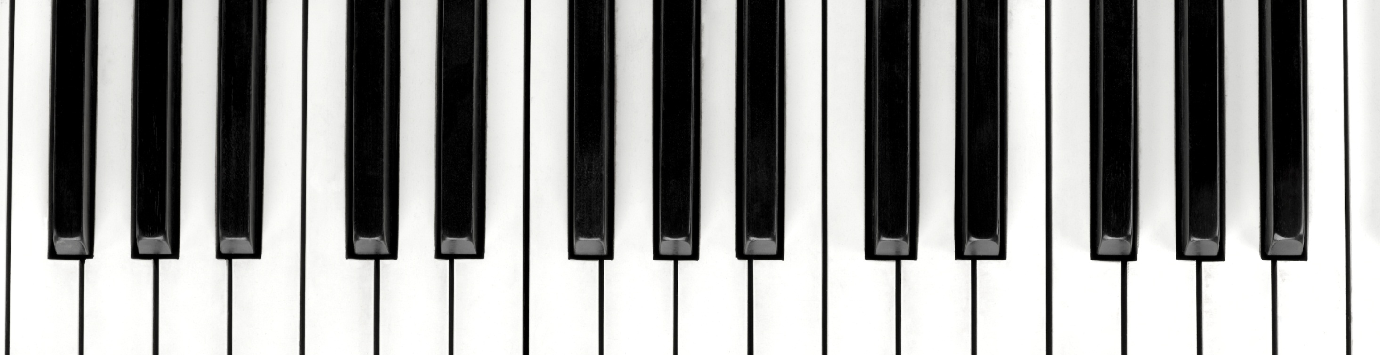
News Sentiments as a Predictor of Music Listening Behaviors
Joo Chung and Jingshi Sun

Slide 2
Introduction
The data science problem: Is there an association between emotional states of individuals and their music listening preferences?
Challenges of study:
Accurately measuring the emotional state of music listeners
Aggregated music listening data
Finding a mechanism to match individuals in a certain emotional state to a song that they are likely to enjoy
News articles that had gained social media traction
Our study is mainly based on three of the six so-called “basic” emotions (i.e., anger, disgust, happiness, sadness, surprise, and fear) which have been studies extensively in social psychology literature (Ekman, 1992): anger, sadness, and happiness

Slide 3
Data Collection
Song data:
Collected the top 5656 songs through Last.fm (9/12/2016 through 9/19/2016)
Lyrics data:
Collected for each of the 5656 songs retrieved from Last.fm through LyricWikia

Slide 4
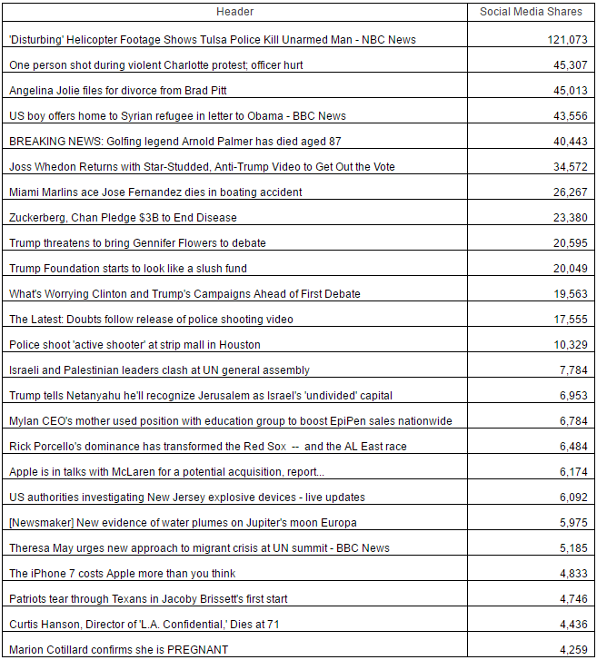
Data Collection
News article data
Collected the top 25 news articles (sorted by social media shares) using EventRegistry
During the week of examination (9/12/2016 through 9/19/2016), news articles were predominantly negatively oriented

Slide 5
Sentiment Analyses
NRC Word-Emotion Lexicon Databse (Mohammad & Turney, 2013)
Crowd-sourced association of word to their emotions using words from The Macquarie Thesaurus (Bernard, 1986)
NLTK package for lemmatization, breaking of contractions, marking negations
Song lyrics:
Percentage of words associated with each emotion were calculated.
Generally good corroboration with actual song lyrics (though with some notable exceptions)

Slide 6
Sentiment Analyses
News Articles:
Percentages for anger, sadness, and joy were 23.15%, 22.74%, and 10.67%, respectively
A metric that measures the cohesion between the song emotion percentages and the week's news emotion percentages through a simple Euclidean distance
Cohesion distance was calculated using the emotion percentages from the six "basic" emotions: anger, fear, surprise, sadness, joy, and disgust.

Slide 7
Cluster Analyses
Cluster analyses were conducted to determine if the songs fell into emotion patterns that could be used for grouping purposes for the longitudinal analyses.
The percentage of anger, sadness, and joy were subject to a K-Means cluster analysis.
Among three methods (K-means, Ward, and DBSCAN) we used, the results from K-means turns out to be most useful.
Cluster | % Anger | % sadness | % joy | Counts
Cluster 0 | 0.333 | 0.408 | 0.190 | 1252
Cluster 1 | 0.102 | 0.119 | 0.162 | 2074
Cluster 2 | 0.099 | 0.137 | 0.573 | 1274

Slide 8
Cluster Analyses

Slide 9
Hypothesis Tests
Whether or not the mean playcount is different between the two clusters (positive and negative) suggested by the K-means clustering algorithm?
Can song playcount be predicted by cohesion distance and song duration?
Can binned cohesion distance (3-levels) be predicted by song duration, number of listeners, playcount, and song rank?
T-test
Ordinary least squares (OLS) linear regression
Support vector machine (SVM)
Naïve Bayes classifier (NB).
Decision tree classifier (DT)
Random forest classifier (RF)
K nearest neighbors algorithm (k-NN).

Slide 10
Hypothesis Tests Results
The means of playcount are not different between the two clusters (positive and negative) suggested by the K-means clustering algorithm.
Song playcount can be predicted by song duration.
Binned cohesion distance (3-levels) cannot be predicted by song duration, number of listeners, playcount, and song rank.

Slide 11
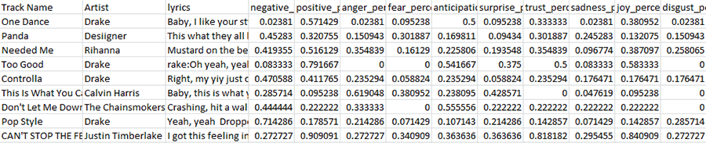
Longitudinal Analyses
Longitudinal data (6/1/2016 to 11/11/2016)
SpotifyCharts which provides the top 200 most-streamed songs for each day
Lyrics were found for 476 of the 737 unique songs
EventRegistry collected top 25 news events for each day
Sentiment analysis was applied to both as with cross-sectional analyses
Descent corroboration of emotion percentages and lyrics for songs

Slide 12
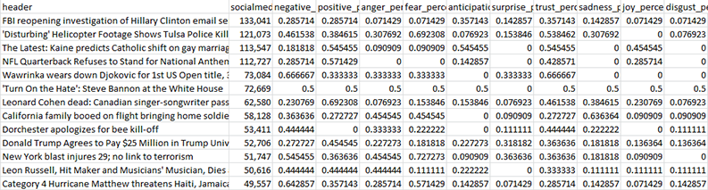
Longitudinal Analyses
Generally poor corroboration of emotion percentages and news articles (possibly due to the tone of impartiality)
Songs were grouped by the K-Means clusters (negative, positive, and null) and their playcounts were averaged for each day

Slide 13
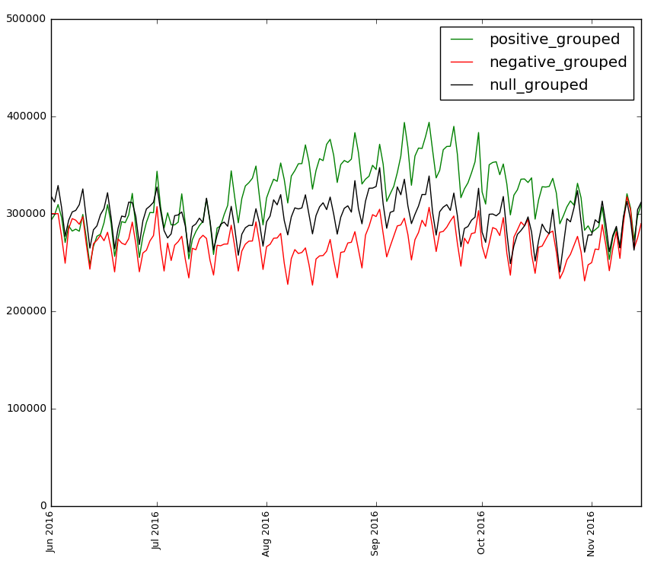
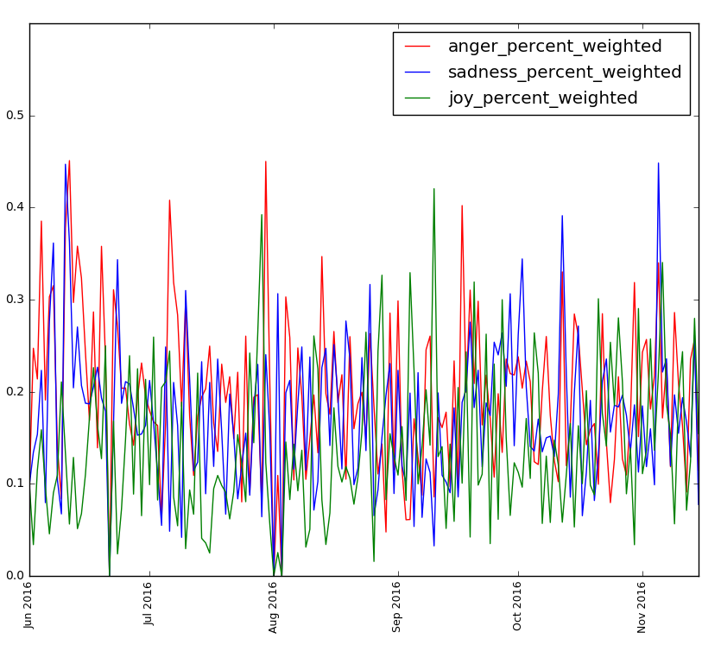
Longitudinal Analyses

Slide 14
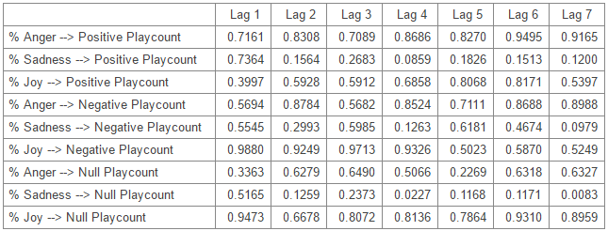
Longitudinal Analyses
Granger Causality tests (news percentages predicting playcounts) were generally non-significant

Slide 15
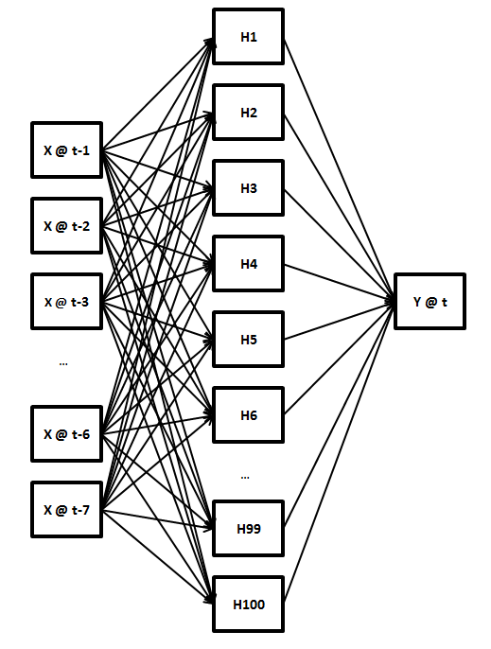
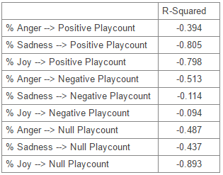
Longitudinal Analyses
Non-linear modeling with Multi-layer Perceptron Regression also indicated that news percentages were poor predictors of song playcounts

Slide 16
Conclusions
The current set of analyses show no evidence of the relationship between the emotional content of news articles and music listening behaviors
The cross-sectional analyses yielded interesting results in regard to song clustering
Limitations
Words that are in common usage in 2016 may have not been adequately represented in the NRC database
The emotional content of news articles generally lacked good correspondence to the actual textual content of the articles
Issues with missing data (particularly for longitudinal lyrics)
Validity of aggregates created by top 200 songs depend on songs entering and leaving the top 200 list at random

Slide 17

Conclusions
Questions or comments?

